Slide 1


Hrishikesh Reddy Papasani
9th June 2023

Slide 2

Outline
Executive Summary
Introduction
Methodology
Results
Conclusion
Appendix

Slide 3
Executive Summary
Following methodologies were used to analyze data:
Data collection from SpaceX REST API and web scraping
Exploratory Data Analysis (Data cleaning, Data exploration & Data Visualization)
Machine Learning model (feature engineering, data scaling, hyperparameter tuning)
Summary of all results:
Required data was available on the internet
Exploratory data analysis helped understand key patterns in data along with recognizing important features for machine learning model development
Machine learning models enabled us to predict landing outcome based of existing data

Slide 4
Introduction
Objective: To evaluate if SpaceY could compete against SpaceX
Questions we are looking answers for:
Which type of rockets have higher landing success rates?
What are the ideal parameters of rockets for different requirements?
What are the ideal launch sites with higher success rates?
What are the optimal landing methods?

Slide 5

Section 1

Slide 6
Methodology
Executive Summary
Data collection methodology:
Data was collected from 2 sources:
- SpaceX REST API
- Wikipedia
Perform data wrangling
Null values were dealt with and insignificant features were removed. After summarization of features, a new categorical target variable for landing outcome was created for further Machine Learning model development.

Slide 7
Methodology
Performed exploratory data analysis (EDA) using visualization and SQL
Performed interactive visual analytics using Folium and Plotly Dash
Performed predictive analysis using classification models
After data was processed, it was scaled and split into 2 parts (Features & Target) which was fed to 4 major classification models. All models were optimized with Hyperparameter tuning. They were properly tested and evaluated.

Slide 8
Data Collection
Data sets were collected from SpaceX API and Wikipedia.
SpaceX API: https://api.spacexdata.com/v4/rockets/
Wikipedia: https://en.wikipedia.org/wiki/List_of_Falcon_9_and_Falcon_Heavy_launches

Slide 9
Data Collection – SpaceX API
We use a public API that enables us to extract data regarding Falcon rocket launches.
Flowchart illustrates how API was used, continued by further data preprocessing methods.
Source code:
Request API &
extract data
Deal with missing values
Filter data to only include Falcon 9 rockets

Slide 10
Data Collection - Scraping
Data was also collected from Wikipedia through Web Scraping.
This was enabled by Python libraries like requests and beautiful soup.
Source code:
Request and scrape the data from source
Extract all column names from HTML table header
Construct data frame by parsing the launch HTML tables

Slide 11
Data Wrangling
A proper data frame is constructed from the data collected.
Exploratory data analysis (EDA) is performed on the data frame.
After summarization, a new ‘landing’ outcome label was created from existing outcome column.
Data frame
created
EDA on data frame & summarization
Creation of landing outcome label
Source code:

Slide 12
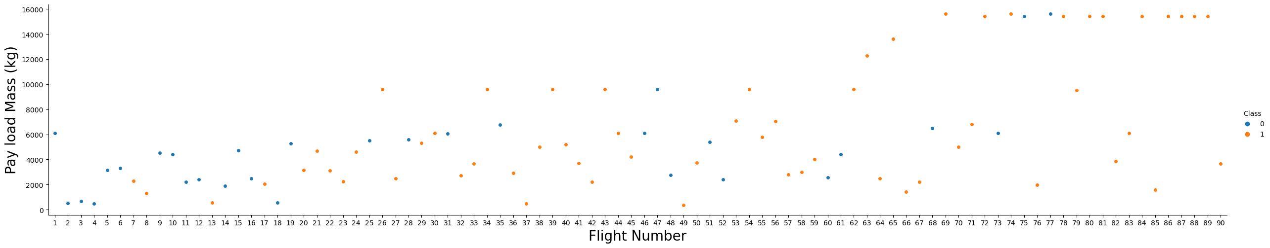
EDA with Data Visualization
Different scatterplots, bar graphs and line graphs were used to explore data and visualize the relationship between different features.
Refer source code:

Slide 13
EDA with SQL
The following SQL queries were performed:
Names of the unique launch sites in the space mission
Top 5 launch sites whose name begin with the string 'CCA’
Total payload mass carried by boosters launched by NASA (CRS)
Average payload mass carried by booster version F9 v1.1
Date when the first successful landing outcome in ground pad was achieved
Names of the boosters which have success in drone ship and have payload mass between 4000 and 6000 kg
Total number of successful and failure mission outcomes
Names of the booster versions which have carried the maximum payload mass;
Failed landing outcomes in drone ship, their booster versions, and launch site names for in year 2015
Rank of the count of landing outcomes (such as Failure (drone ship) or Success (ground pad)) between the date 2010-06-04 and 2017-03-20.

Slide 14
Build an Interactive Map with Folium
Markers, circles, lines and marker clusters were used with Maps
Markers indicate different launch sites
Circles indicate highlighted areas around specific coordinates, like NASA Johnson Space Centre
Marker clusters indicate groups of events in each coordinate, like launches in a launch site
Lines are used to indicate distances between two relevant coordinates.
Source code:

Slide 15
Build a Dashboard with Plotly Dash
The following graphs and plots were used to visualize data
Percentage of launches by site
Payload range
This combination enabled us to analyse the relation between payloads and launch sites, helping to identify the best place to launch according to payloads.
Source code:

Slide 16
Predictive Analysis (Classification)
Four models on 4 namely: Logistic regression, Decision tree, Support vector machine and K-nearest neighbors were trained and tested.
All are trained and tested over different combinations of parameters. Optimal parameters are chosen for each model and the model with the highest accuracy is finally chosen
Data scaling and splitting
Model creation & Hyperparameter tuning
Model with optimal score selected
Source code selected:

Slide 17
Results
Space X uses 4 different launch sites
Most amount of payloads have been sent to Geostationary transfer orbit (GTO)
The first successful landing outcome occurred in 2015, five years after the first launch
Drone ships are most extensively used for landing rockets.
Many Falcon 9 booster versions having payload above the average were successful at landing in drone ships
All 5 landing attempts of flights that sent payloads to SSO (Sun-synchronous orbit) were successful.
Flights with top 3 largest payloads have gone to VLEO (Very low earth orbit) and a majority of recent Falcon 9 flights also delivered payloads in the VLEO region
Cape Canaveral launch site (CCAFS SLC-40) is the most used extensively used launch site by SpaceX.
Two booster versions failed at landing in drone ships in 2015: F9 v1.1 B1012 and F9 v1.1 B1015;
Landing success rates have consistently improved over the years.

Slide 18
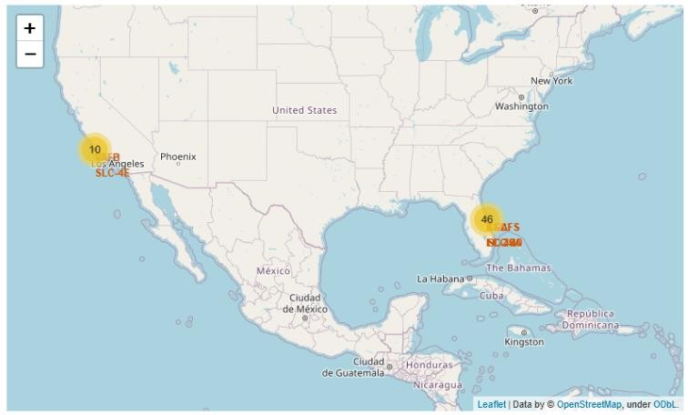
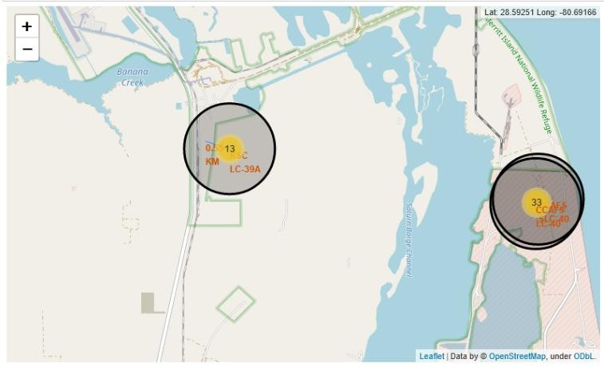
Results
All launch sites are in safe places (near sea) and have a good logistic infrastructure around.
Most launches occur at east coast launch sites.

Slide 19
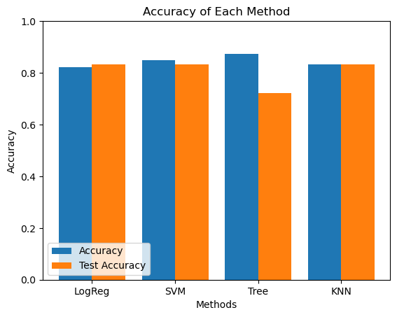
Results
Support vector machine works best to predict successful landings overall having an accuracy of around 84% and similar test data accuracy.

Slide 20

Section 2

Slide 21
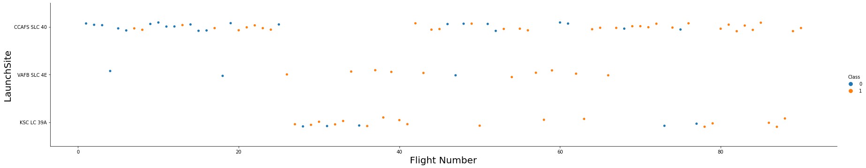
Flight Number vs. Launch Site
From the plot above, we can see that CCAF5 SLC- 40 is the most used site with also the most success
In second place VAFB SLC 4E and third place KSC LC 39A
We can further observe that the general success rate improved over time.

Slide 22
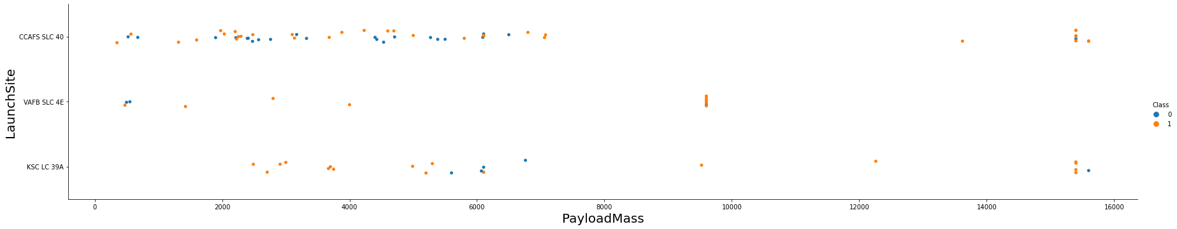
Payload vs. Launch Site
Payloads over 9,000kg have great success rates
Payloads over 12,000kg have been sent only from CCAFS SLC 40 and KSC LC
39A launch sites.

Slide 23
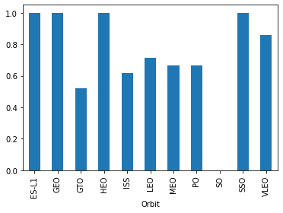
Success Rate vs. Orbit Type
The highest success rates in orbits:
ES-L1
GEO
HEO
…

Slide 24
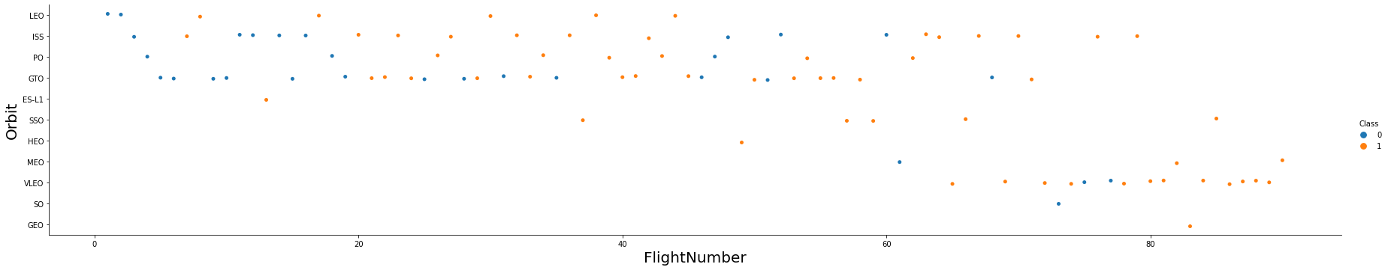
Flight Number vs. Orbit Type
Success rate improved over time in all orbits
VLEO orbit seems to be a new business opportunity, due to recent increase in its frequency.

Slide 25
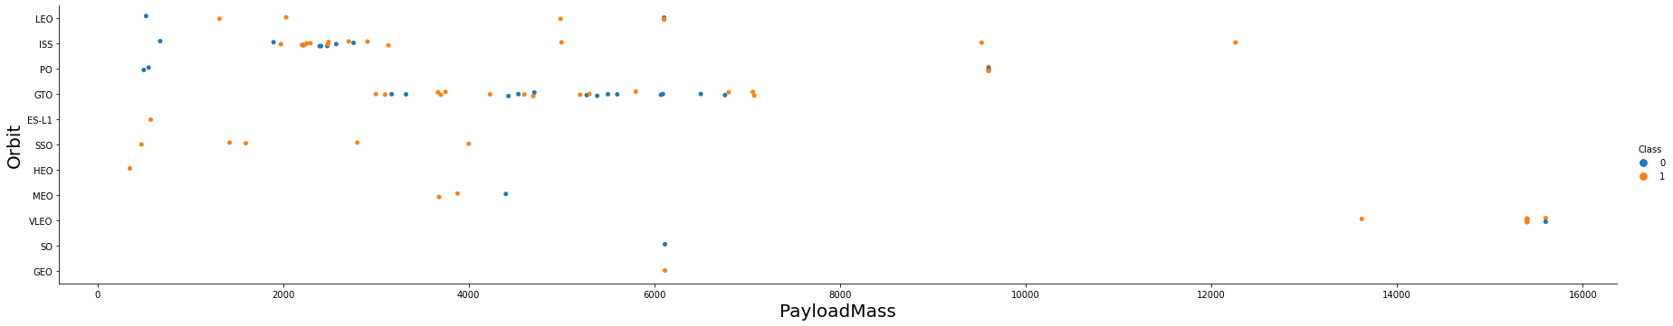
Payload vs. Orbit Type
There is no relation between payload and success rate to orbit GTO
The largest payloads have been sent to VLEO
There are very few launches to the orbits SO and GEO.

Slide 26
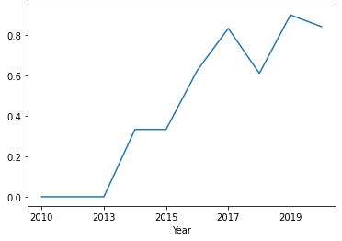
Launch Success Yearly Trend
There was no success (or attemps) of landings in the first three years.
Success rate started increasing in 2013 and
kept until recent times.

Slide 27
All Launch Site Names
According to data, there are four launch sites:
Launch Site
CCAFS LC-40
CCAFS SLC-40
KSC LC-39A
VAFB SLC-4E
The above are obtained by selecting unique occurrences of “launch_site” values from the dataset.

Slide 28
Launch Site Names Begin with 'CCA'
5 records where launch sites begin with `CCA`:
Date | Time UTC | Booster Version | Launch Site | Payload | Payload Mass kg | Orbit | Customer | Mission Outcome | Landing Outcome
2010-06-04 | 18:45:00 | F9 v1.0 B0003 | CCAFS LC-40 | Dragon Spacecraft Qualification Unit | 0 | LEO | SpaceX | Success | Failure (parachute)
2010-12-08 | 15:43:00 | F9 v1.0 B0004 | CCAFS LC-40 | Dragon demo flight C1, two CubeSats, barrel of Brouere cheese | 0 | LEO (ISS) | NASA (COTS) NRO | Success | Failure (parachute)
2012-05-22 | 07:44:00 | F9 v1.0 B0005 | CCAFS LC-40 | Dragon demo flight C2 | 525 | LEO (ISS) | NASA (COTS) | Success | No attempt
2012-10-08 | 00:35:00 | F9 v1.0 B0006 | CCAFS LC-40 | SpaceX CRS-1 | 500 | LEO (ISS) | NASA (CRS) | Success | No attempt
2013-03-01 | 15:10:00 | F9 v1.0 B0007 | CCAFS LC-40 | SpaceX CRS-2 | 677 | LEO (ISS) | NASA (CRS) | Success | No attemp

Slide 29
Total Payload Mass
Total payload carried by boosters from NASA:
Total Payload (kg)
111.268
We arrived at the number above by summing all payloads whose codes contain ‘CRS’, which corresponds to NASA.

Slide 30
Average Payload Mass by F9 v1.1
Average payload mass carried by booster version F9 v1.1:
Avg Payload (kg)
2.928
We came to this number by filtering data by the booster version and calculating average payload mass.

Slide 31
First Successful Ground Landing Date
First successful landing outcome on ground pad:
Min Date
2015-12-22
By filtering data based on landing outcome (on ground pad) and getting the minimum value for date we identified the first occurrence.

Slide 32
Successful Drone Ship Landing with Payload between 4000 and 6000
Boosters which have successfully landed on drone ship and had payload mass greater than 4000 and less than 6000:
Booster Version
F9 FT B1021.2
F9 FT B1031.2
F9 FT B1022
F9 FT B1026
Selecting distinct booster versions based on the filters above, we arrived at these results.

Slide 33
Total Number of Successful and Failure Mission Outcomes
Number of successful and failure mission outcomes:
Mission Outcome | Occurrences
Success | 99
Success (payload status unclear) | 1
Failure (in flight) | 1
Grouping mission outcomes and counting records for each group led us to the result above.

Slide 34
Boosters Carried Maximum Payload
Boosters which have carried the maximum payload mass
Booster Version (...)
F9 B5 B1048.4
F9 B5 B1048.5
F9 B5 B1049.4
F9 B5 B1049.5
F9 B5 B1049.7
F9 B5 B1051.3
Booster Version
F9 B5 B1051.4
F9 B5 B1051.6
F9 B5 B1056.4
F9 B5 B1058.3
F9 B5 B1060.2
F9 B5 B1060.3
These are the boosters which have carried the maximum payload mass registered in the dataset.

Slide 35
2015 Launch Records
Failed landing outcomes in drone ships, their booster versions, and launch site names for the year 2015
Booster Version | Launch Site
F9 v1.1 B1012 | CCAFS LC-40
F9 v1.1 B1015 | CCAFS LC-40
The list above has the only two occurrences.

Slide 36
Rank Landing Outcomes Between 2010-06-04 and 2017-03-20
Ranking of all landing outcomes between the dates 2010-06-04 and 2017-03-20:
Landing Outcome | Occurrences
No attempt | 10
Failure (drone ship) | 5
Success (drone ship) | 5
Controlled (ocean) | 3
Success (ground pad) | 3
Failure (parachute) | 2
Uncontrolled (ocean) | 2
Precluded (drone ship) | 1

Slide 37

Section 3

Slide 38
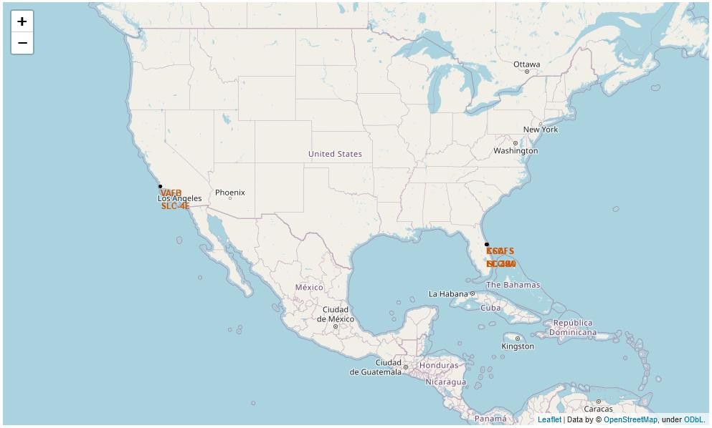
All launch sites
Launch sites are present on the eastern and western coasts with most launches occurring at the eastern coast.
38

Slide 39

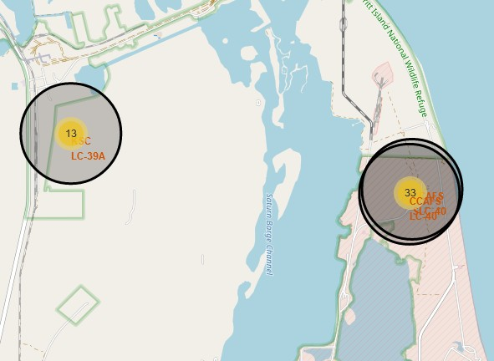
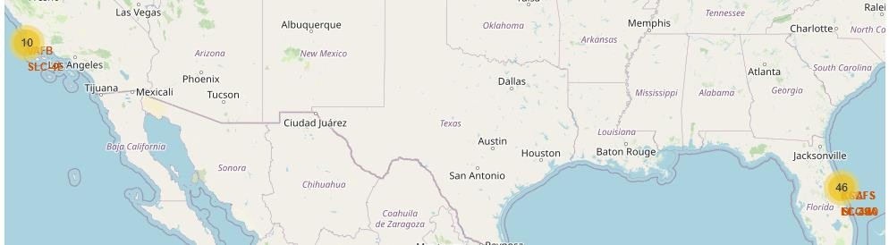

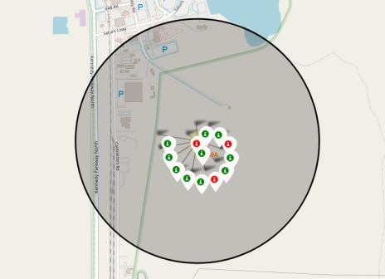
Launch outcomes by Site
Example of KSC LC-39A launch site launch outcomes
Green markers indicate success and red ones indicate failure.

Slide 40
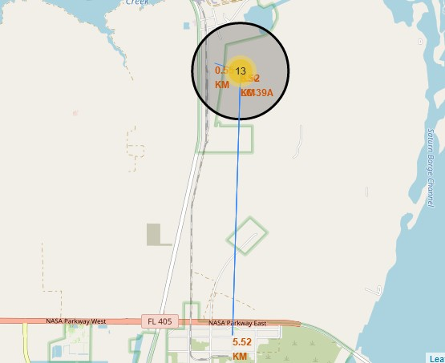
Logistics and safety
Launch site KSC LC-39A has good logistical aspects, railroads and roads are present while being relatively far from any population centers.

Slide 41

Section 4

Slide 42
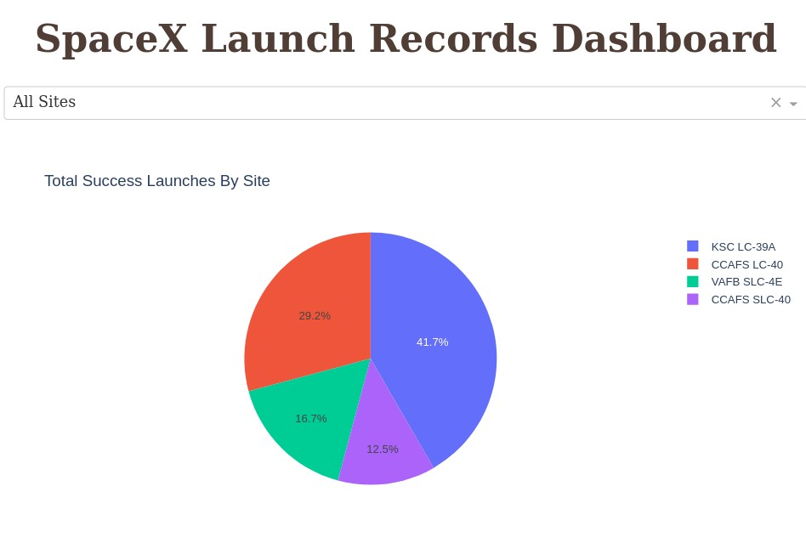
Successful launches by Site
The site from where launches are done is a very important factor for success of different missions.

Slide 43
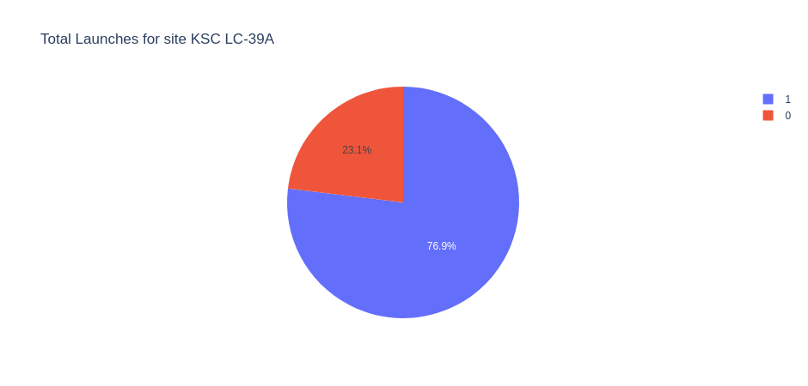
Launch success ratio for KSC LC-39A
Almost 77% of launches are successful in this site.

Slide 44
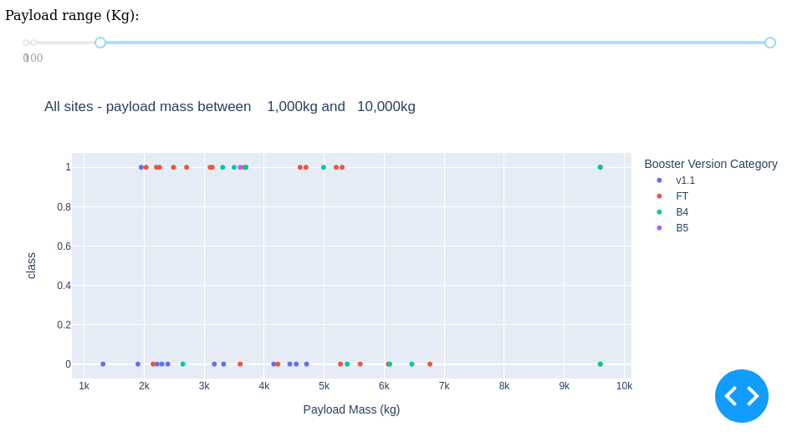
Payload vs Launch outcome
Payloads under 6,000kg and FT boosters are the most successful combination.

Slide 45
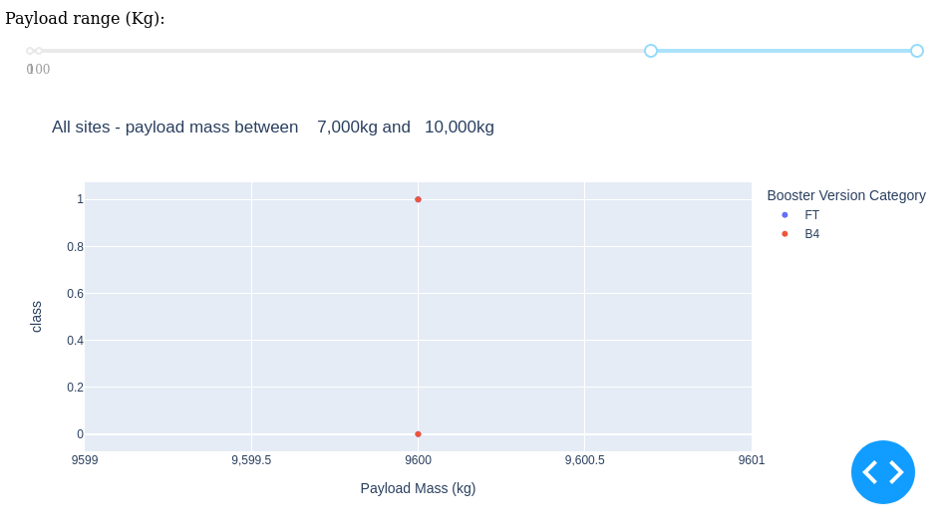
Payload vs Launch outcome
There’s not enough data to estimate risk of launches over 7,000kg

Slide 46

Section 5

Slide 47
Classification Accuracy
Four classification models were tested.
Support Vector Machine provides the highest accuracy with test and overall accuracies of around 84%.

Slide 48
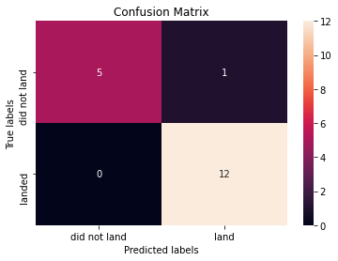
Confusion Matrix
Confusion matrix of Decision Tree Classifier illustrates high accuracy by showing the higher values of true positive and true negative compared to the false ones.

Slide 49
Conclusions
Data was extracted from multiple sources and properly analyzed
Launches with payloads above 7,000 kgs have higher success rates.
Biggest payloads usually go to VLEO.
Landing success rates consistently improved over time taking in consideration the evolution of rocket system technologies.
Decision Tree Classifier provides most accurate predictions of the landing outcomes based of the existing data

Slide 50
Appendix
For consistent accuracy results for models across different runs, set any value to np.random.seed() or use Cross validation.
Data cutoff is 2020. Improved results & conclusions can be achieved given newer data considering the large amount of major advancements and feats in the recent times.
Github link to the entire project:

Slide 51


